Slide 1



Business insights 360. Codebasics
View in Power BI
Last data refresh:
9/25/2024 3:02:35 PM UTC
Downloaded at:
10/16/2024 3:40:14 PM UTC

Slide 2
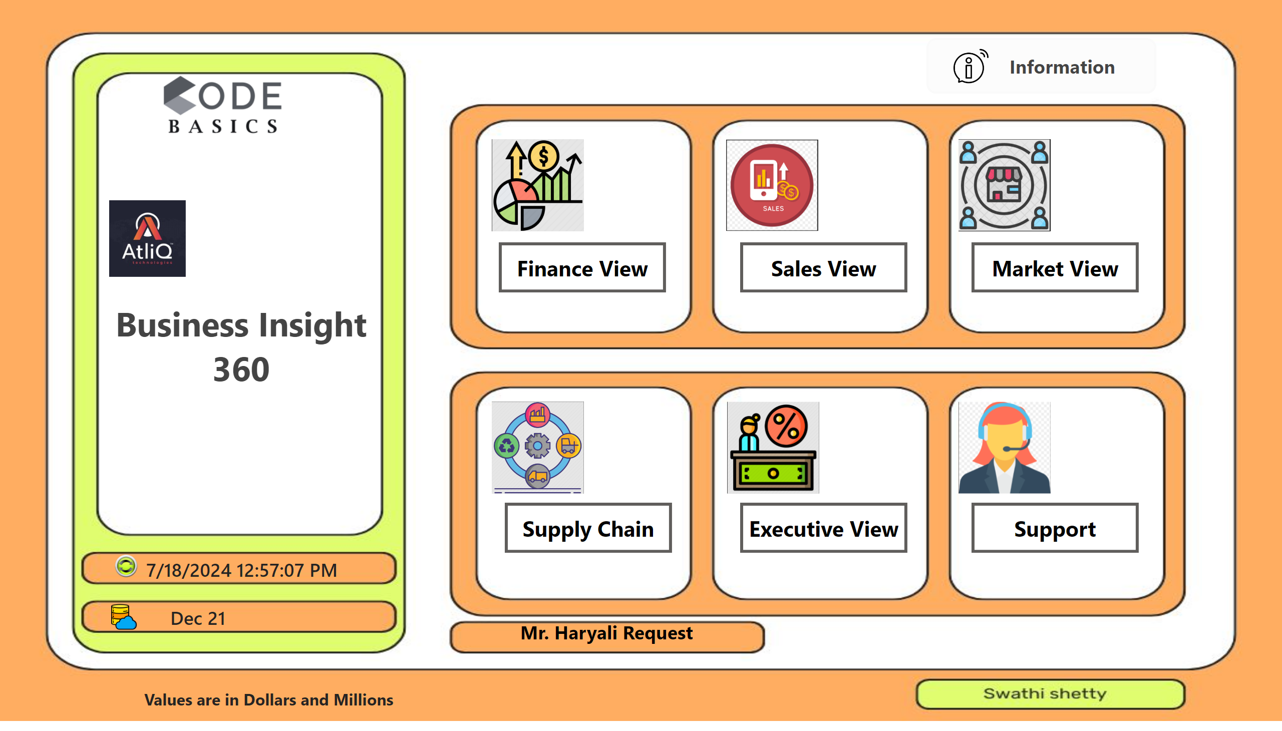
Home
Notes:
actionButton
No alt text provided
shape
No alt text provided
image
No alt text provided
cardVisual
No alt text provided
cardVisual
No alt text provided
actionButton
No alt text provided
Finance view icon
No alt text provided
Sales view icon
No alt text provided
Market view icon
No alt text provided
Supply chain view icon
No alt text provided
executive view icon
No alt text provided
Market view icon
No alt text provided
actionButton
No alt text provided
actionButton
No alt text provided
actionButton
No alt text provided
actionButton
No alt text provided
actionButton
No alt text provided
actionButton
No alt text provided
image
No alt text provided
image
No alt text provided
actionButton
No alt text provided
textbox
No alt text provided

Slide 3
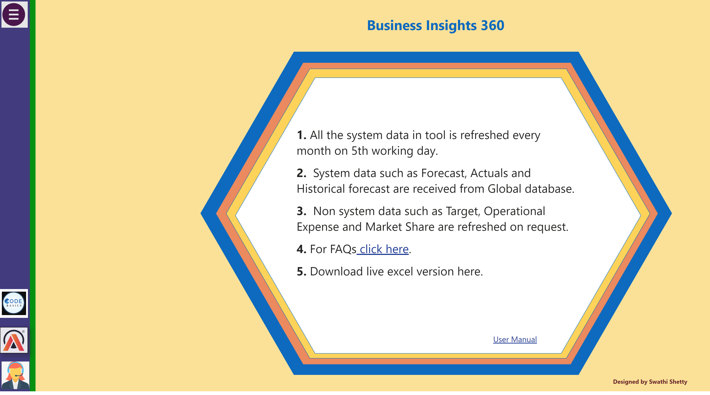
Info
Notes:
actionButton
No alt text provided
actionButton
No alt text provided
actionButton
No alt text provided
actionButton
No alt text provided
actionButton
No alt text provided
actionButton
No alt text provided
actionButton
No alt text provided
actionButton
No alt text provided
actionButton
No alt text provided
shape
No alt text provided
actionButton
No alt text provided
Help
No alt text provided
Menu
No alt text provided
textbox
No alt text provided
image
No alt text provided
image
No alt text provided
textbox
No alt text provided
shape
No alt text provided
shape
No alt text provided
shape
No alt text provided
shape
No alt text provided
textbox
No alt text provided
textbox
No alt text provided

Slide 4
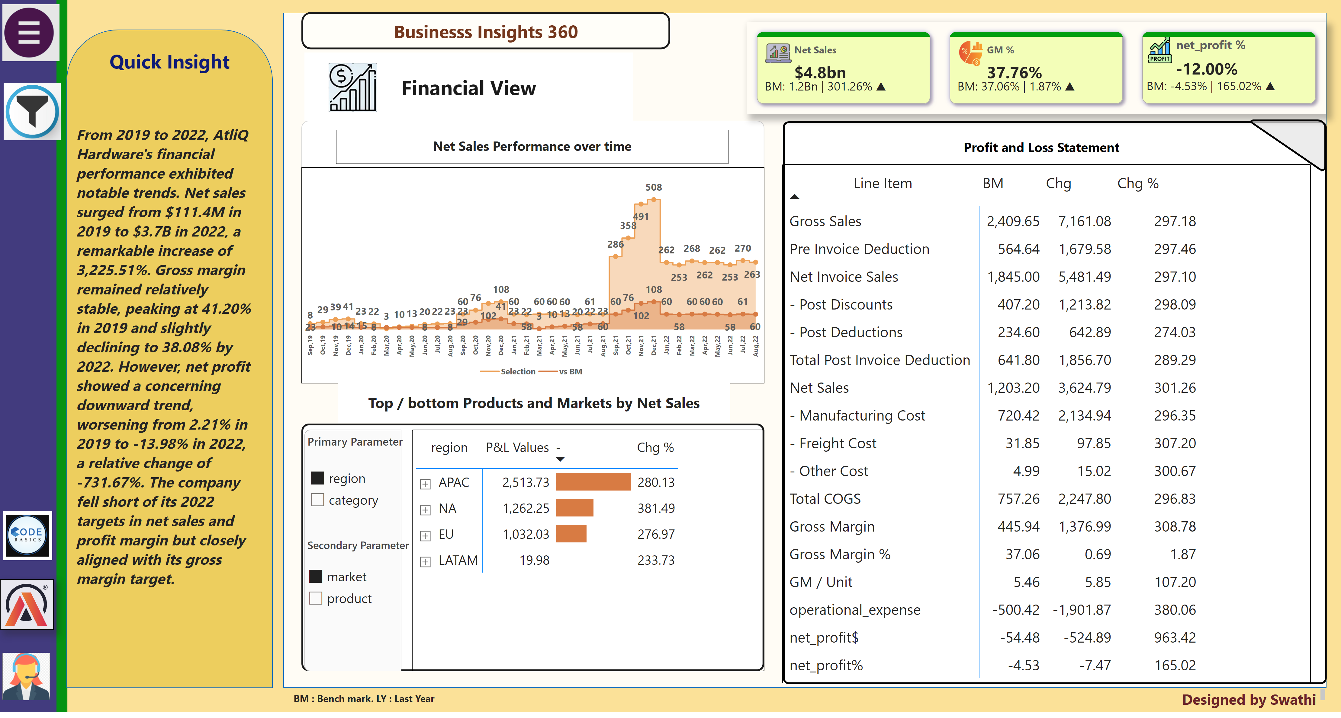
Finance report
Notes:
actionButton
No alt text provided
actionButton
No alt text provided
actionButton
No alt text provided
actionButton
No alt text provided
actionButton
No alt text provided
actionButton
No alt text provided
actionButton
No alt text provided
actionButton
No alt text provided
shape
No alt text provided
shape
No alt text provided
actionButton
No alt text provided
actionButton
No alt text provided
Help
No alt text provided
filter icon
No alt text provided
Menu
No alt text provided
shape
No alt text provided
slicer
No alt text provided
slicer
No alt text provided
slicer
No alt text provided
slicer
No alt text provided
slicer
No alt text provided
slicer
No alt text provided
slicer
No alt text provided
shape
No alt text provided
actionButton
No alt text provided
textbox
No alt text provided
cardVisual
No alt text provided
image
No alt text provided
image
No alt text provided
textbox
No alt text provided
Highlights
No alt text provided
shape
No alt text provided
shape
No alt text provided
shape
No alt text provided
shape
No alt text provided
pivotTable
No alt text provided
shape
No alt text provided
shape
No alt text provided
Net Sales Performance over time
No alt text provided
card
No alt text provided
shape
No alt text provided
shape
No alt text provided
shape
No alt text provided
pivotTable
No alt text provided
slicer
No alt text provided
slicer
No alt text provided
shape
No alt text provided
image
No alt text provided
card
No alt text provided
shape
No alt text provided
textbox
No alt text provided

Slide 5
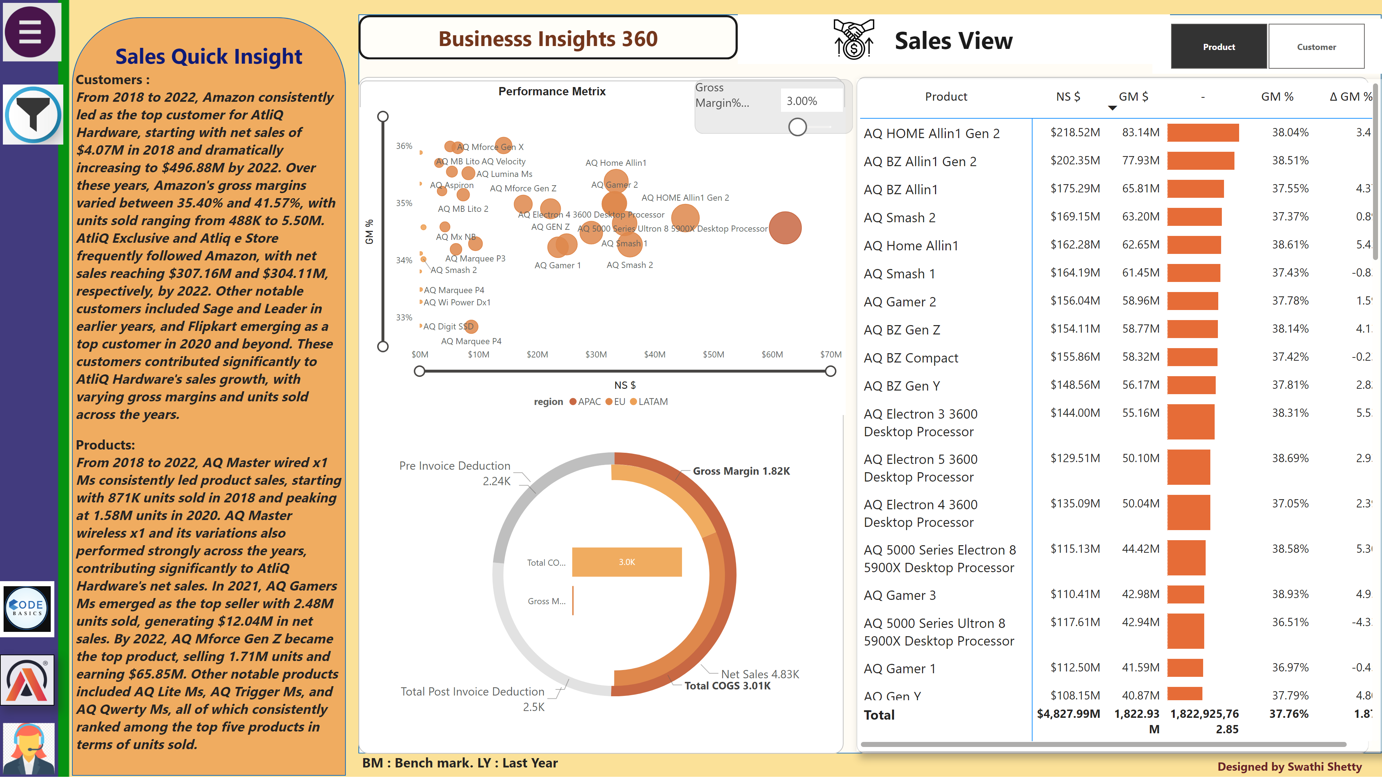
Sales report
Notes:
actionButton
No alt text provided
actionButton
No alt text provided
actionButton
No alt text provided
actionButton
No alt text provided
actionButton
No alt text provided
actionButton
No alt text provided
actionButton
No alt text provided
actionButton
No alt text provided
shape
No alt text provided
shape
No alt text provided
actionButton
No alt text provided
actionButton
No alt text provided
Help
No alt text provided
filter icon
No alt text provided
Menu
No alt text provided
shape
No alt text provided
slicer
No alt text provided
slicer
No alt text provided
slicer
No alt text provided
slicer
No alt text provided
slicer
No alt text provided
slicer
No alt text provided
slicer
No alt text provided
shape
No alt text provided
actionButton
No alt text provided
textbox
No alt text provided
image
No alt text provided
image
No alt text provided
textbox
No alt text provided
Highlights
No alt text provided
shape
No alt text provided
shape
No alt text provided
image
No alt text provided
scatterChart
No alt text provided
slicer
No alt text provided
donutChart
No alt text provided
donutChart
No alt text provided
slicer
No alt text provided
clusteredBarChart
No alt text provided
shape
No alt text provided
pivotTable
No alt text provided
shape
No alt text provided
shape
No alt text provided
shape
No alt text provided
shape
No alt text provided
shape
No alt text provided
textbox
No alt text provided
textbox
No alt text provided

Slide 6
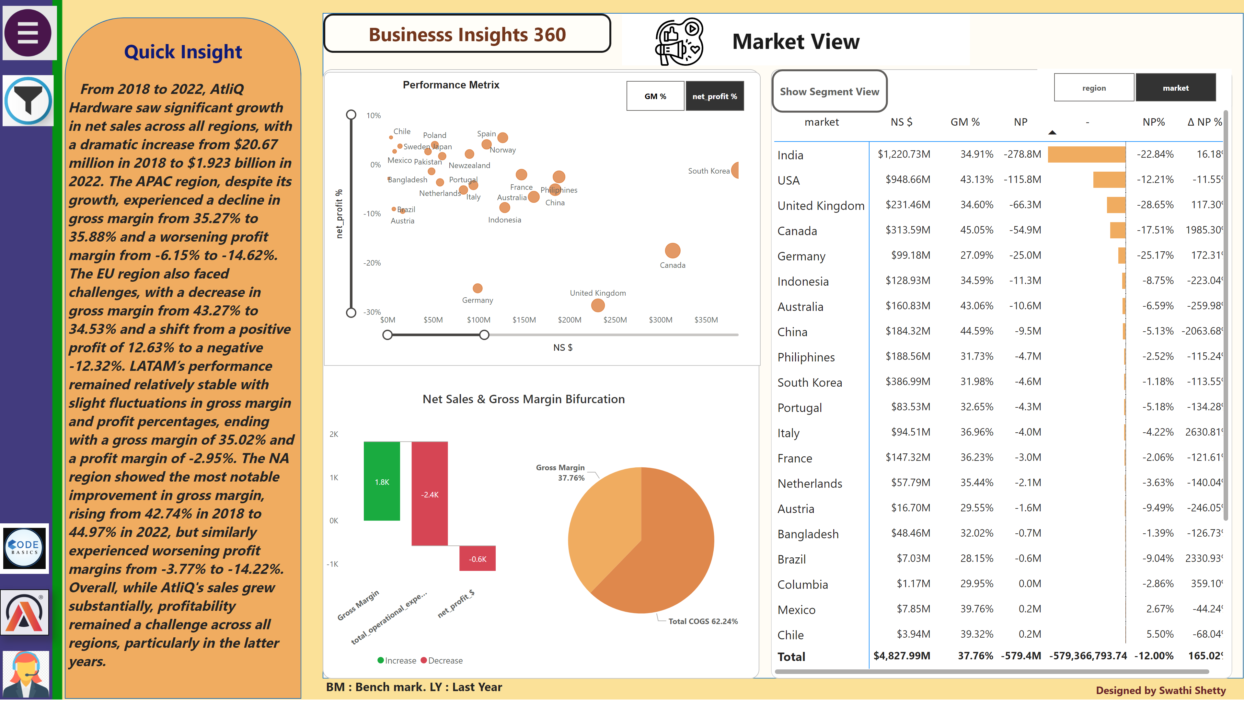
Market report
Notes:
waterfallChart
No alt text provided
shape
No alt text provided
pivotTable
No alt text provided
actionButton
No alt text provided
show segment view
No alt text provided
textbox
No alt text provided
slicer
No alt text provided
pieChart
No alt text provided
slicer
No alt text provided
actionButton
No alt text provided
Show GM%
No alt text provided
GM% Visual
No alt text provided
image
No alt text provided
textbox
No alt text provided
market /region slicer
No alt text provided
market view
No alt text provided
shape
No alt text provided
shape
No alt text provided
shape
No alt text provided
shape
No alt text provided
slicer
No alt text provided
shape
No alt text provided
shape
No alt text provided
shape
No alt text provided
Highlights
No alt text provided
textbox
No alt text provided
image
No alt text provided
image
No alt text provided
textbox
No alt text provided
actionButton
No alt text provided
shape
No alt text provided
slicer
No alt text provided
slicer
No alt text provided
slicer
No alt text provided
slicer
No alt text provided
slicer
No alt text provided
slicer
No alt text provided
slicer
No alt text provided
shape
No alt text provided
Menu
No alt text provided
filter icon
No alt text provided
Help
No alt text provided
actionButton
No alt text provided
actionButton
No alt text provided
shape
No alt text provided
shape
No alt text provided
actionButton
No alt text provided
actionButton
No alt text provided
actionButton
No alt text provided
actionButton
No alt text provided
actionButton
No alt text provided
actionButton
No alt text provided
actionButton
No alt text provided
actionButton
No alt text provided

Slide 7
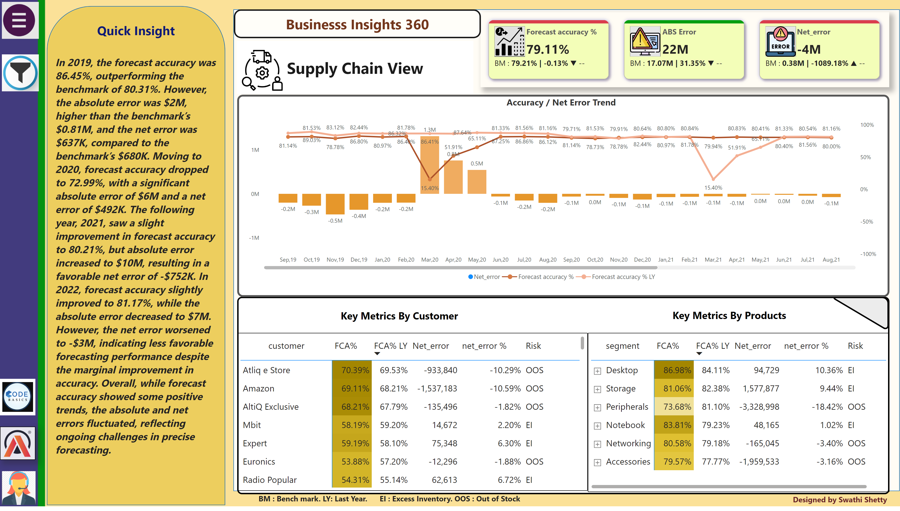
Supply Chain report
Notes:
actionButton
No alt text provided
actionButton
No alt text provided
actionButton
No alt text provided
actionButton
No alt text provided
actionButton
No alt text provided
actionButton
No alt text provided
actionButton
No alt text provided
actionButton
No alt text provided
shape
No alt text provided
shape
No alt text provided
actionButton
No alt text provided
actionButton
No alt text provided
Help
No alt text provided
filter icon
No alt text provided
Menu
No alt text provided
shape
No alt text provided
slicer
No alt text provided
slicer
No alt text provided
slicer
No alt text provided
slicer
No alt text provided
slicer
No alt text provided
slicer
No alt text provided
slicer
No alt text provided
shape
No alt text provided
actionButton
No alt text provided
textbox
No alt text provided
cardVisual
No alt text provided
image
No alt text provided
image
No alt text provided
Highlights
No alt text provided
shape
No alt text provided
shape
No alt text provided
shape
No alt text provided
shape
No alt text provided
shape
No alt text provided
shape
No alt text provided
Net Sales Performance over time
No alt text provided
shape
No alt text provided
image
No alt text provided
Net Sales Performance over time
No alt text provided
shape
No alt text provided
lineClusteredColumnComboChart
No alt text provided
shape
No alt text provided
textbox
No alt text provided
textbox
No alt text provided
textbox
No alt text provided

Slide 8
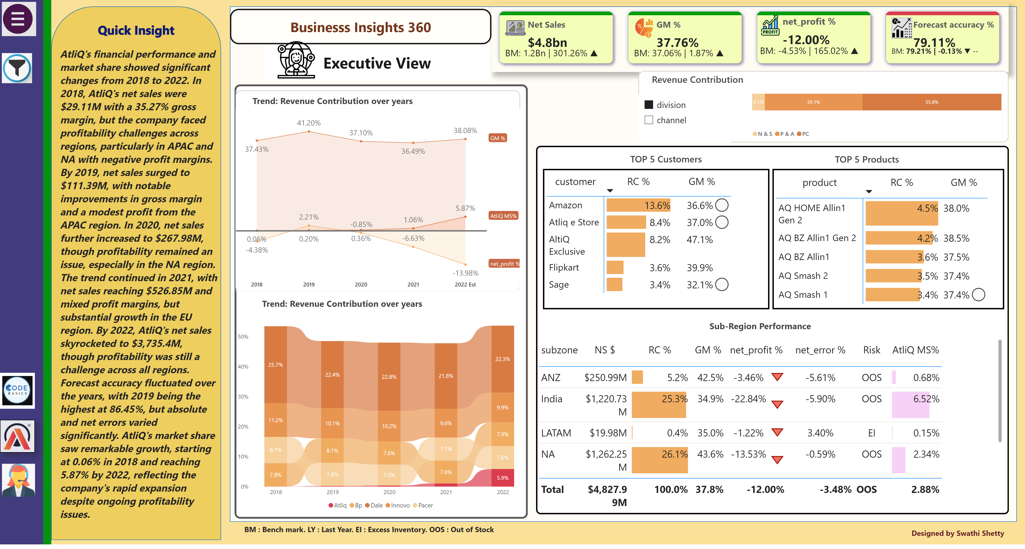
Executive report
Notes:
actionButton
No alt text provided
actionButton
No alt text provided
actionButton
No alt text provided
actionButton
No alt text provided
actionButton
No alt text provided
actionButton
No alt text provided
actionButton
No alt text provided
actionButton
No alt text provided
shape
No alt text provided
shape
No alt text provided
actionButton
No alt text provided
actionButton
No alt text provided
Help
No alt text provided
filter icon
No alt text provided
Menu
No alt text provided
shape
No alt text provided
slicer
No alt text provided
slicer
No alt text provided
slicer
No alt text provided
slicer
No alt text provided
slicer
No alt text provided
slicer
No alt text provided
slicer
No alt text provided
shape
No alt text provided
actionButton
No alt text provided
textbox
No alt text provided
image
No alt text provided
image
No alt text provided
textbox
No alt text provided
Highlights
No alt text provided
shape
No alt text provided
shape
No alt text provided
shape
No alt text provided
shape
No alt text provided
shape
No alt text provided
cardVisual
No alt text provided
image
No alt text provided
pivotTable
No alt text provided
pivotTable
No alt text provided
shape
No alt text provided
shape
No alt text provided
tableEx
No alt text provided
shape
No alt text provided
ribbonChart
No alt text provided
shape
No alt text provided
areaChart
No alt text provided
shape
No alt text provided
hundredPercentStackedBarChart
No alt text provided
shape
No alt text provided
slicer
No alt text provided
shape
No alt text provided
shape
No alt text provided
textbox
No alt text provided

Slide 9
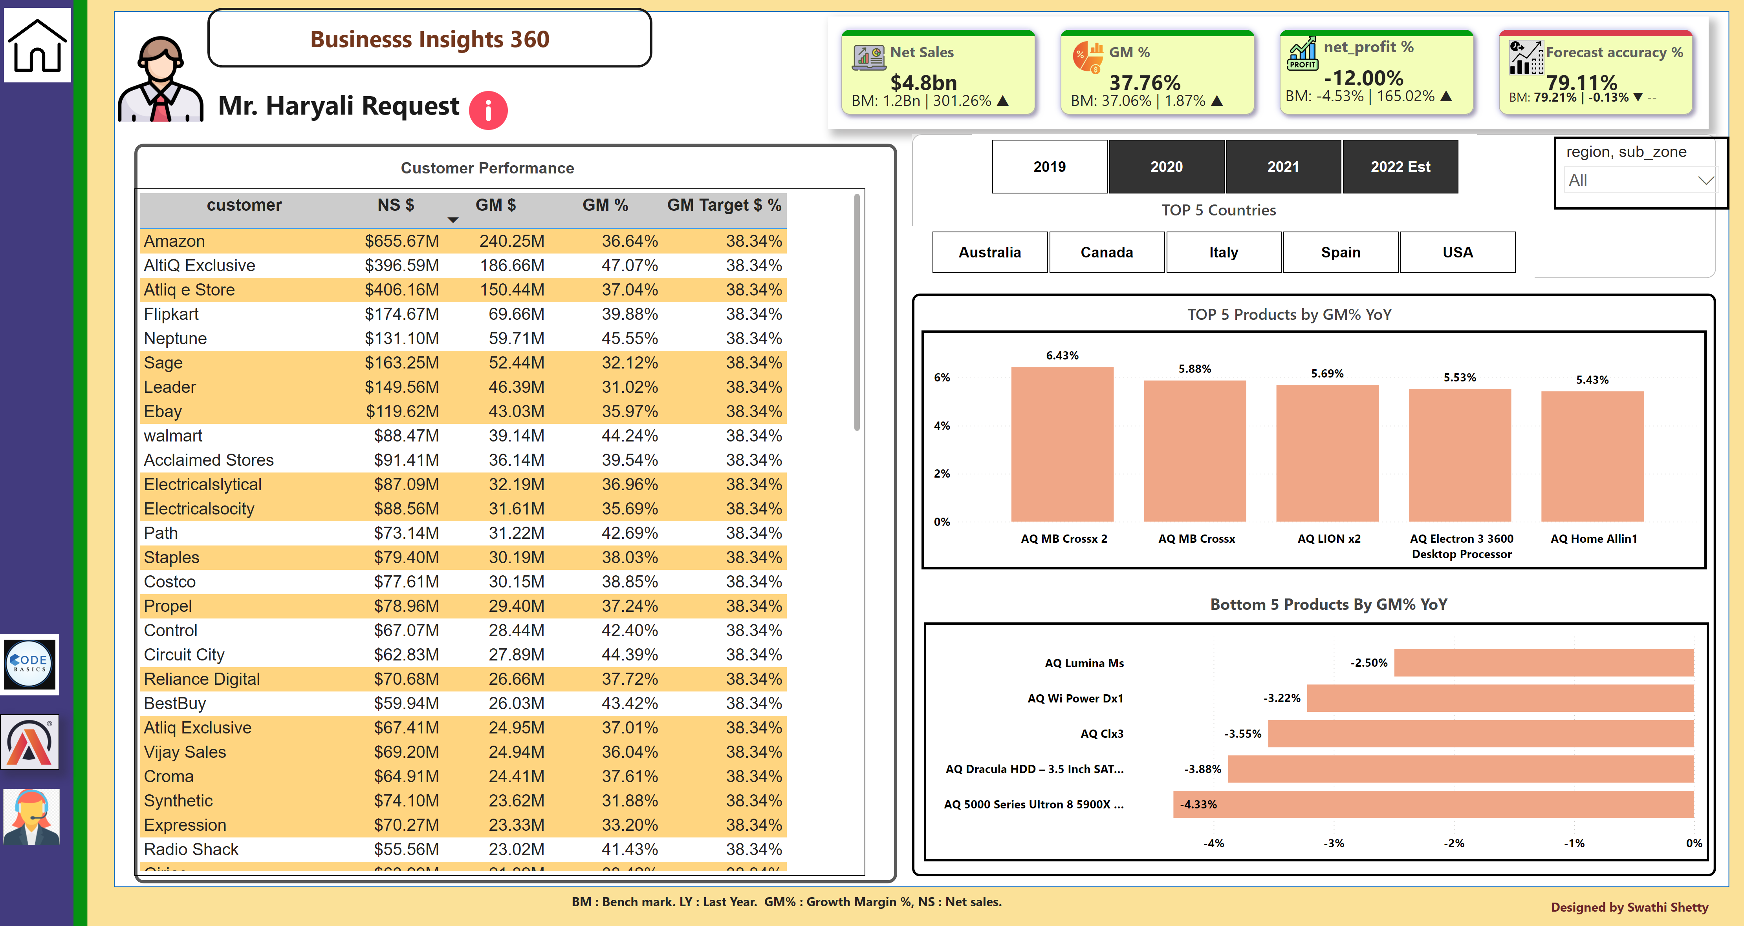
Mr. Haryali Request
Notes:
actionButton
No alt text provided
actionButton
No alt text provided
actionButton
No alt text provided
actionButton
No alt text provided
actionButton
No alt text provided
actionButton
No alt text provided
actionButton
No alt text provided
actionButton
No alt text provided
shape
No alt text provided
shape
No alt text provided
actionButton
No alt text provided
actionButton
No alt text provided
Help
No alt text provided
shape
No alt text provided
slicer
No alt text provided
slicer
No alt text provided
slicer
No alt text provided
slicer
No alt text provided
slicer
No alt text provided
slicer
No alt text provided
slicer
No alt text provided
shape
No alt text provided
actionButton
No alt text provided
textbox
No alt text provided
image
No alt text provided
image
No alt text provided
textbox
No alt text provided
shape
No alt text provided
shape
No alt text provided
shape
No alt text provided
shape
No alt text provided
shape
No alt text provided
cardVisual
No alt text provided
clusteredColumnChart
No alt text provided
shape
No alt text provided
shape
No alt text provided
shape
No alt text provided
image
No alt text provided
image
No alt text provided
tableEx
No alt text provided
slicer
No alt text provided
barChart
No alt text provided
slicer
No alt text provided
shape
No alt text provided
shape
No alt text provided
FY Filter
No alt text provided
image
No alt text provided

Slide 10
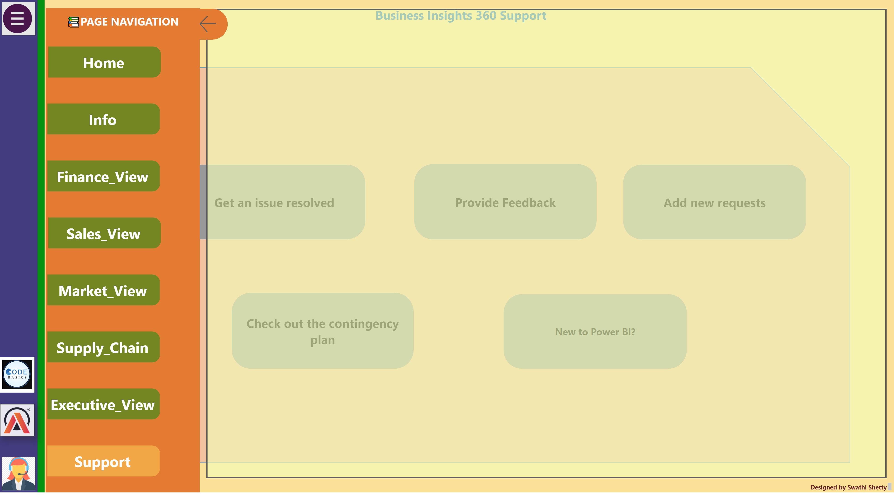
Support
Notes:
Help
No alt text provided
textbox
No alt text provided
Menu
No alt text provided
Home
No alt text provided
Info
No alt text provided
Finance
No alt text provided
actionButton
No alt text provided
Market_view
No alt text provided
Supply chain
No alt text provided
Executive
No alt text provided
support
No alt text provided
flyout
No alt text provided
close cover
No alt text provided
close button
No alt text provided
shape
No alt text provided
textbox
No alt text provided
shape
No alt text provided
shape
No alt text provided
shape
No alt text provided
shape
No alt text provided
shape
No alt text provided
image
No alt text provided
image
No alt text provided

Slide 11
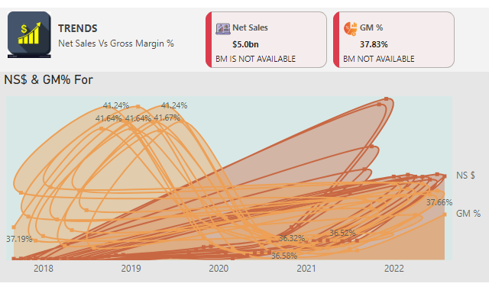
Sales_trend(tool-tip)
Notes:
NS$ & GM% For
No alt text provided
shape
No alt text provided
shape
No alt text provided
cardVisual
No alt text provided
image
No alt text provided

Slide 12
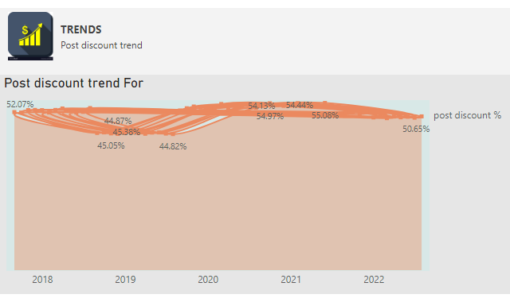
post discount_trend(tool-tip)
Notes:
Post discount trend For
No alt text provided
shape
No alt text provided
shape
No alt text provided
image
No alt text provided

